Slide 1
ALGORITHMS FOR PARALLEL COMPUTERS

Slide 2
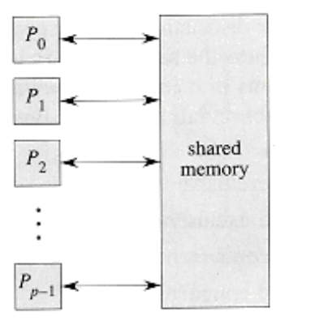
PRAM MODEL
In order to study parallel algorithms, we must choose an appropriate model for parallel computing.
The parallel random-access machine, or PRAM model.
Many parallel algorithms for arrays, lists, trees, and graphs can be easily described in the PRAM model.

Slide 3
There are p ordinary (serial) processors P₀, P₁, . . . , P_{p}-1 that have as storage a shared, global memory.
All processors can read from or write to the global memory "in parallel" (at the same time).
The processors can also perform various arithmetic and logical operations in parallel.
The key assumption regarding algorithmic performance in the PRAM model is that running time can be measured as the number of parallel memory accesses an algorithm performs.
This assumption is a straight- forward generalization of the ordinary RAM model, in which the number of memory accesses is asymptotically as good as any other measure of running time.

Slide 4
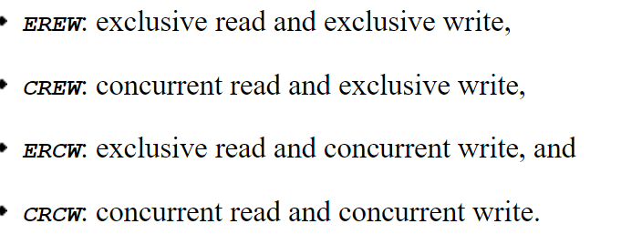
Concurrent versus exclusive memory accesses
A concurrent-read algorithm is a PRAM algorithm during whose execution multiple processors can read from the same location of shared memory at the same time.
An exclusive-read algorithm is a PRAM algorithm in which no two processors ever read the same memory location at the same time.

Slide 5
Of these types of algorithms, the extremes--EREW and CRCW--are the most popular.
A PRAM that supports only EREW algorithms is called an EREW PRAM, and one that supports CRCW algorithms is called a CRCW PRAM.
A CRCW PRAM can, of course, execute EREW algorithms, but an EREW PRAM cannot directly support the concurrent memory accesses required in CRCW algorithms.
The underlying hardware of an EREW PRAM is relatively simple, and therefore fast, because it needn't handle conflicting memory reads and writes.

Slide 6
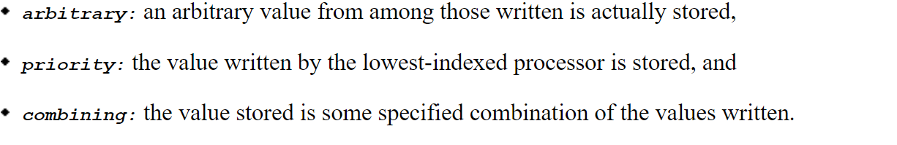
When multiple processors write to the same location in a CRCW algorithm, the effect of the parallel write need additional elaboration.

Slide 7
Pointer jumping
Pointer jumping provides a fast way to manipulate lists in parallel.
All of the algorithms in this section are EREW algorithms: no concurrent accesses to global memory are required.
List ranking
We can store a list in a PRAM much as we store lists in an ordinary RAM.
To operate on list objects in parallel, however, it is convenient to assign a "responsible" processor to each object.
We shall assume that there are as many processors as list objects, and that the ith processor is responsible for the ith object.

Slide 8
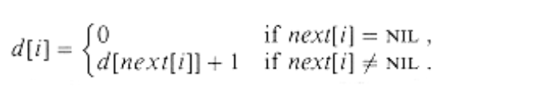
Suppose that we are given a singly linked list L with n objects and wish to compute, for each object in L, its distance from the end of the list. More formally, if next is the pointer field, we wish to compute a value d[i] for each object i in the list such that
One solution to the list-ranking problem is simply to propagate distances back from the end of the list.
This method takes θ(n) times , since the kth object from the end before it can determine its own.
This solution is essentially a serial algorithm.

Slide 9
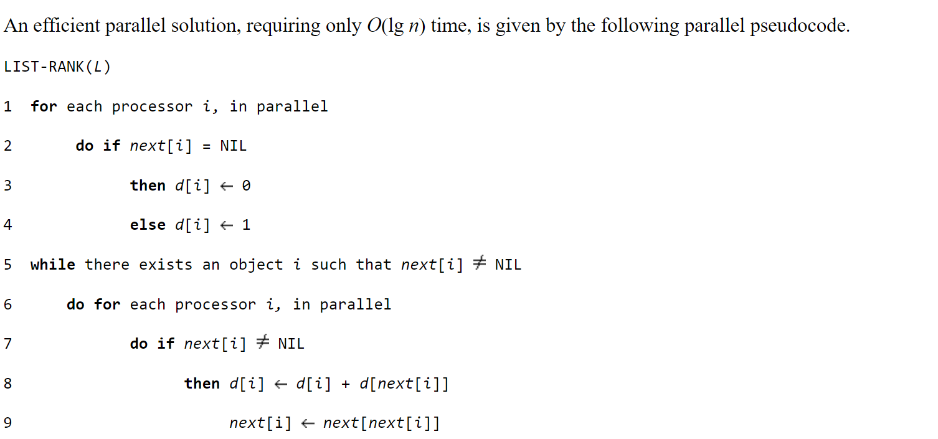

Slide 10
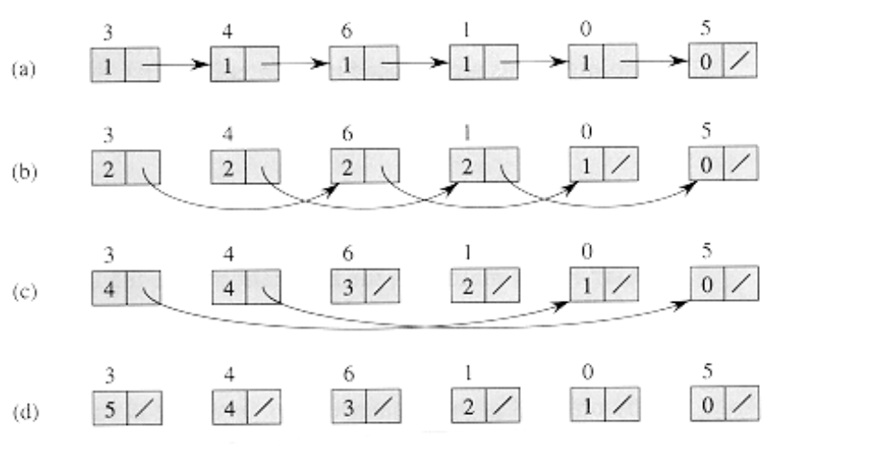

Slide 11
Analysis

